Slide 1
Triple-band MIMO Antenna for 5G Mobile Applications

Slide 2
ABSTRACT
In this paper, a multiple input multiple output (MIMO) 4-antenna array is proposed and designed for 5G mobile terminal communication.
The antenna array is composed of four triple-band antennas placed along the long edges on both sides of the terminal.
It adopts a bent structure to achieve miniaturization and can cover the ISM (Industry Science Medicine) frequency band of 2370-to-2450MHz, and the 5G operating frequency bands of 3510-to-3610MHz and 4830-to-5080MHz allocated by the Ministry of Industry and Information Technology.

Slide 3
INTRODUCTION
In order to address the demand of higher data rates and greater channel capacity, multiple input multiple output (MIMO) antenna technology will be applied to fifth-generation (5G) communication applications.
In MIMO solutions, a large number of antennas will be placed in the limited space of the mobile terminal. Increasing spectrum efficiency can effectively improve communication capabilities.
However, due to the limited spectrum resources, it is necessary to increase the operating frequency of the antenna.

Slide 4
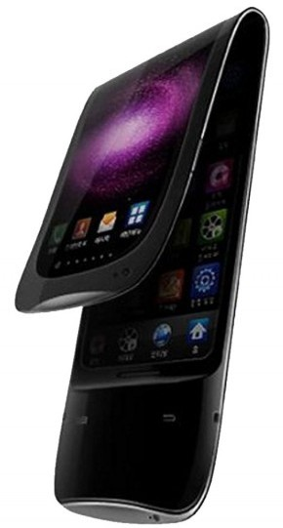
Types of Antennas used in Cell Phones
Following are some of the antennas used in cellular phones:
External Antenna
Retractable Monopole (whips) antenna
Helical antennas
Internal Antennas
Planar inverted-F antennas (PIFA)

Slide 5
Antenna Structure
This design uses Ansys HFSS software for simulation.
Three-band four-antenna MIMO system geometry for mobile terminals. All antenna elements are located on both sides of the 134mmx75mm ground plane.
The four antenna elements are printed on two rectangular substrates placed perpendicular to the main system substrate. The size of the substrates is 134mmx5.2mmx0.8mm.
These two regions are dedicated to the placement of other antennas used in LTE and current mobile terminals to ensure compatibility with other systems.

Slide 6
MIMO ANTENNA
MIMO( multiple input, multiple output) is an antenna technology for wireless communications in which multiple antennas are used at both the source (transmitter) and the destination (receiver).
MIMO antenna provides a maximum throughput of 300Mbps

Slide 7
FREQUENCY OF MIMO ANTENNA
The MIMO antenna functions with isolation of more than 15.4 dB in the frequency region from 5.6 to 5.8 GHz .
The maximum achieved gain for this antenna is >1.41 dBi across the applicable band and can be implemented in portable devices for WLAN applications at 5.7 GHz.

Slide 8
Increasing antennas is good?
Diversity Gain decreases as the number of antennas are increases.
This increase the chances of signal cross talk.

Slide 9
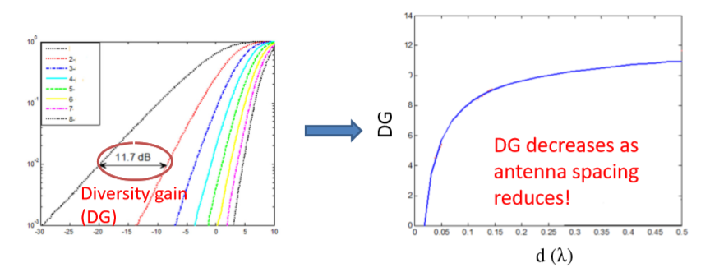

Slide 10
CONCLUSION
We present the design process followed by simulation and measurement verifications.
A novel MIMO antenna suitable for 5G frequency band is proposed in this paper.
By using an appropriate feeding structure and feeding method, three resonant modes are excited.
The prototype antenna shows good bandwidth performance and radiation efficiency, making it an appealing structure to be employed for 5G mobile terminal communication.

Slide 11
REFERENCE
J. G. Andrews, et al, “What will 5G be?,” IEEE Journal on Selected Areas in Communications, vol. 32, no. 6, pp. 1065-1082, June 2014.
Z. Ren, A. Zhao and S. Wu, "Dual-Band MIMO Antenna System for 5G Mobile Terminals," 2019 13th European Conference on Antennas and Propagation (EuCAP), Krakow, Poland, 2019, pp. 1-4.
S. Nej and A. Ghosh, "Design of Meander Line Triple Band Antenna for Wireless Applications," 2020

